Slide 1
FuzzY C-MEANS Algorithm
Zhiyuan Wang
12032878
Fuzzy Clustering

Slide 2
Content
Fuzzy C-Means Algorithm
The effect of m in the Fuzzy C-Means Algorithm
K-Means and Fuzzy C-Means Algorithm

Slide 3

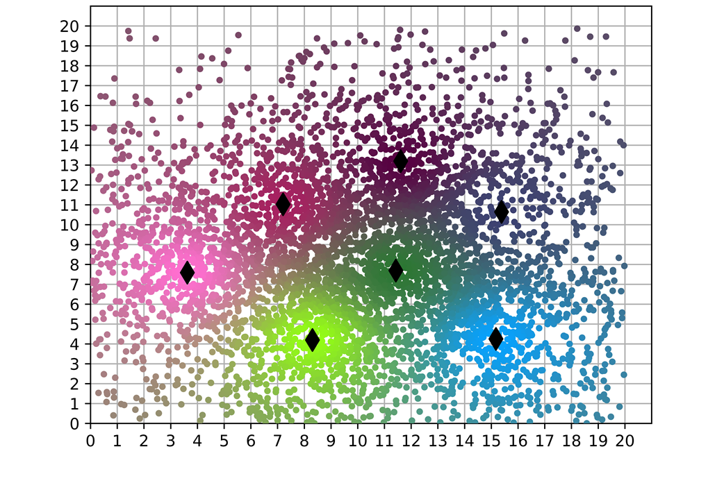

Fuzzy C-Means Algorithm
The site will have relation to each center.
Iterate the following two steps from randomly specified values of $μ_{ij}$
$$c_{j}=\frac{\sum_{i=1}^{n}{{\left(μ_{ij}\right)}^{m}s_{i}}}{\sum_{i=1}^{n}{{\left(μ_{ij}\right)}^{m}}},j=1,2,…,k$$
$$μ_{ij}={\left[\sum_{h=1}^{k}{{\left(\frac{dist\left(s_{i},c_{j}\right)}{dist\left(s_{i},c_{h}\right)}\right)}^{\frac{2}{m−1}}}\right]}^{−1}\text{for} \text{all} i \text{and} j$$

Slide 4
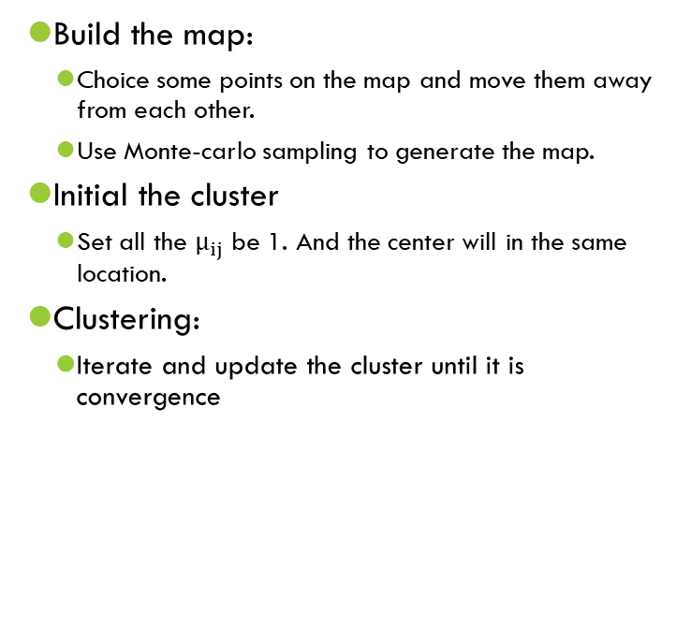
Fuzzy C-Means Algorithm
Build the map:
Choice some points on the map and move them away from each other.
Use Monte-carlo sampling to generate the map.
Initial the cluster
Set all the $μ_{ij}$ be 1. And the center will in the same location.
Clustering:
Iterate and update the cluster until it is convergence

Slide 5
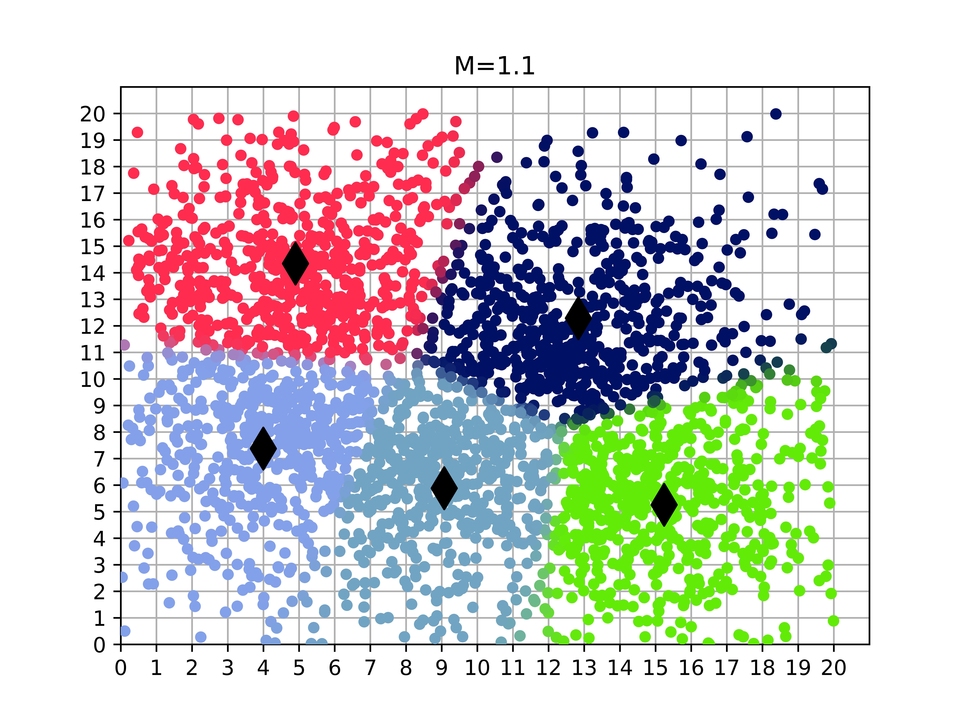
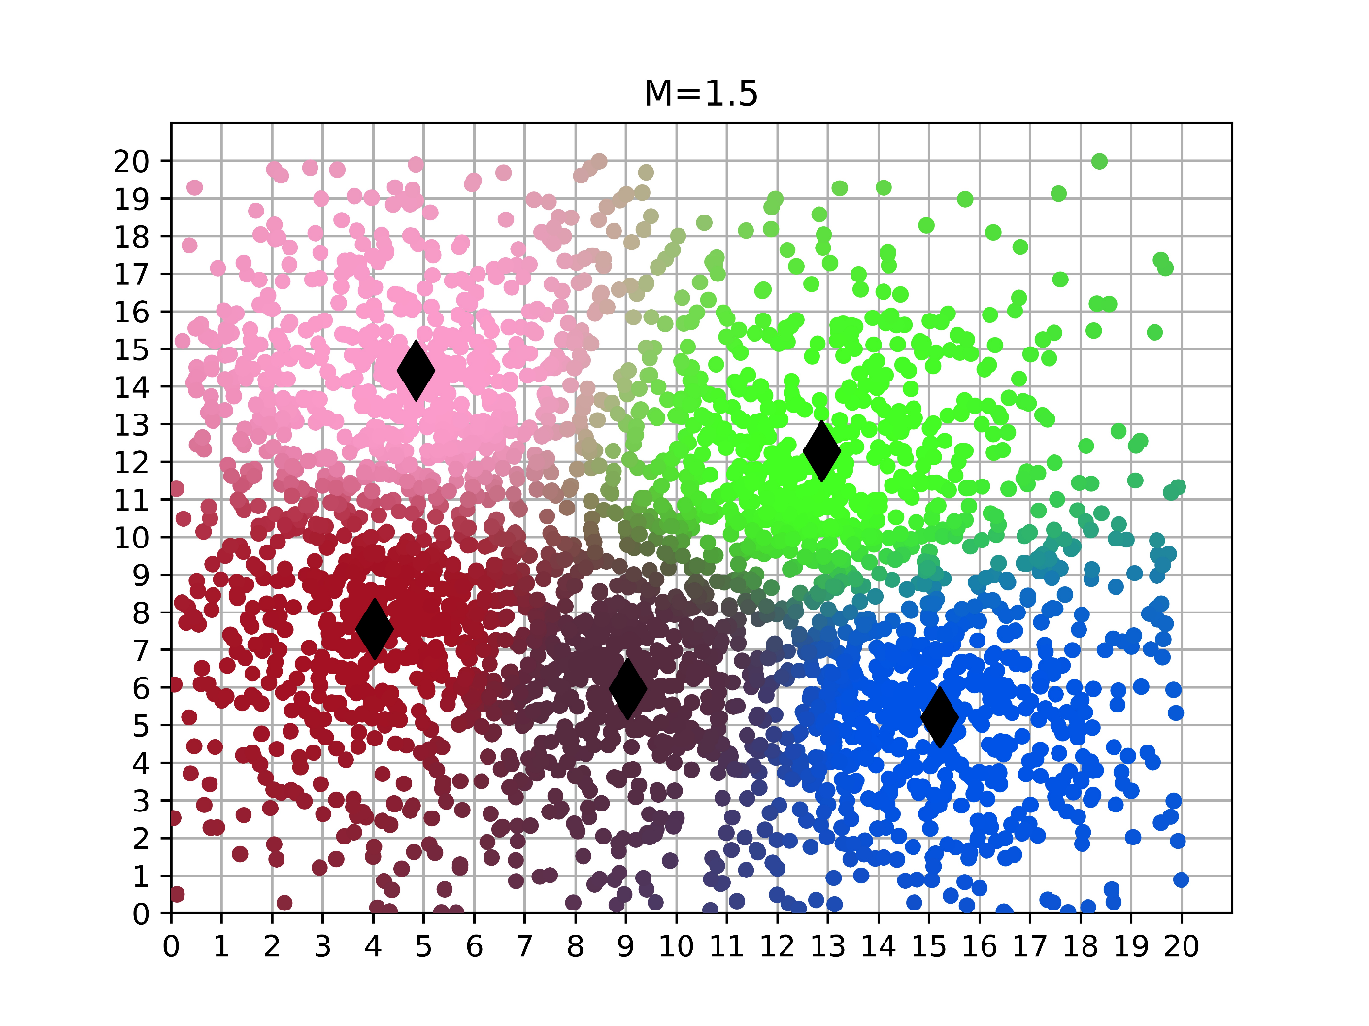
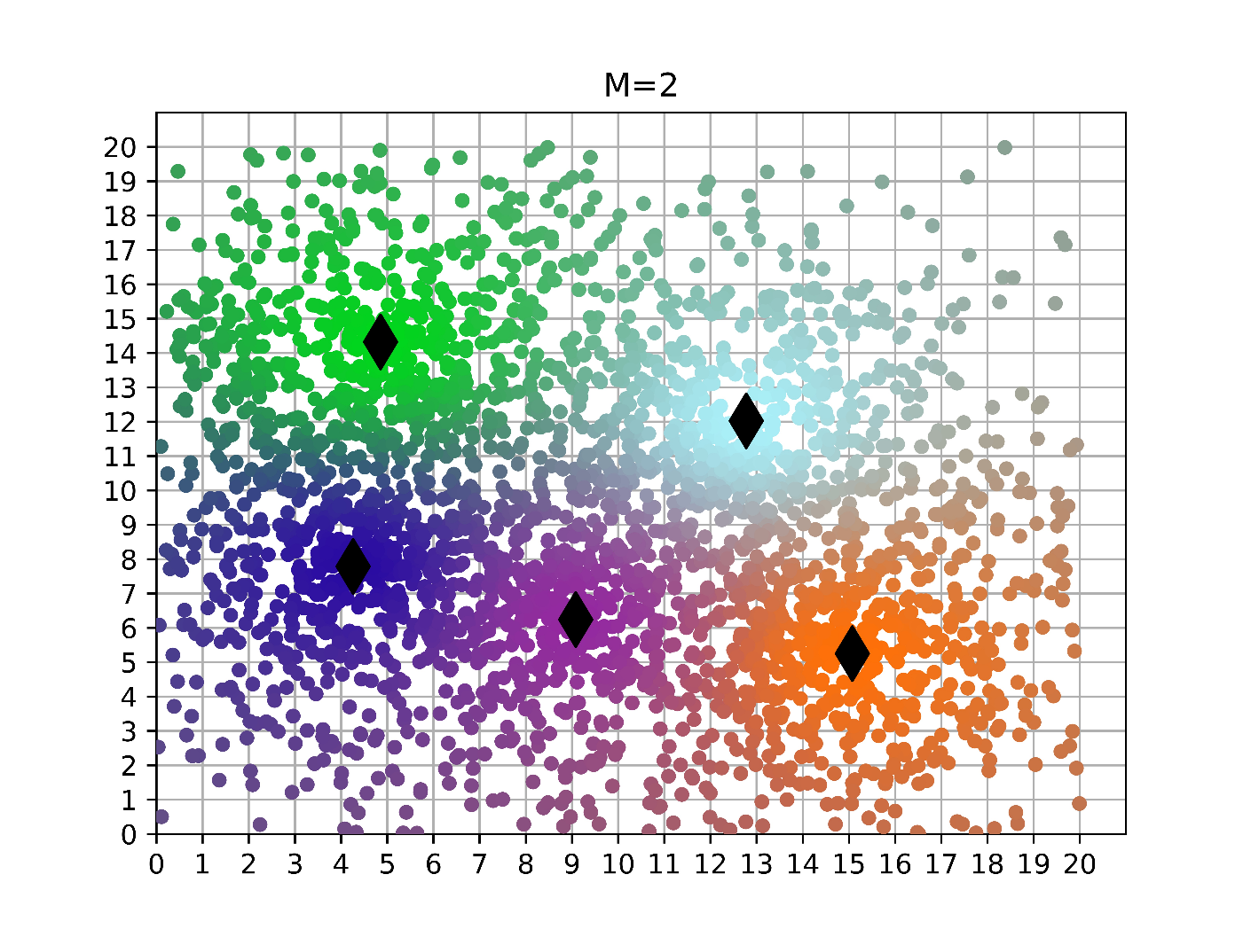
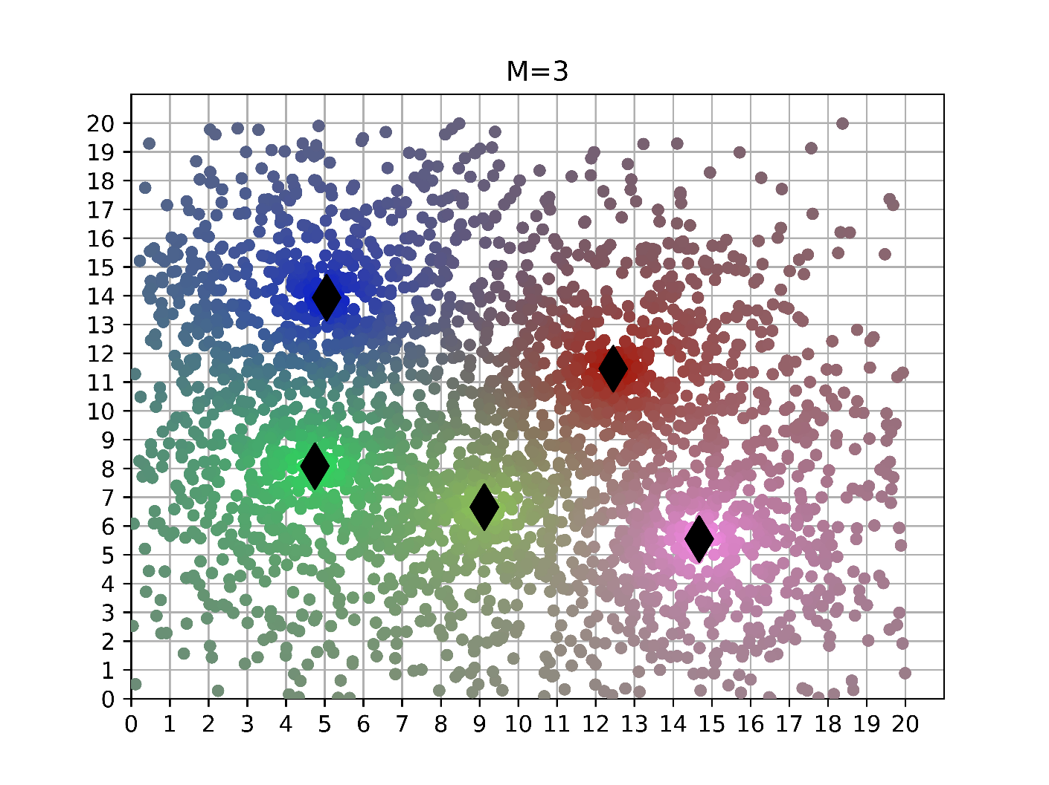
The effect of m in the Fuzzy C-Means Algorithm
When m increase, the boundary of the colors will be more “fuzzy”

Slide 6
K-Means and Fuzzy C-Means Algorithm
K-Means
Fuzzy C-Means

Slide 7
K-Means and Fuzzy C-Means Algorithm
K-Means
Fuzzy C-Means

Slide 8

K-Means and Fuzzy C-Means Algorithm
K-Means: In the K-Means, each site only in one partition. it is only related to one center.
Fuzzy C-Means: In the Fuzzy C-Means, a site have relations to all the centers, the distance is closer, the relation is stronger.

Slide 9
Thank You !
Q&A

